Slide 1

CpSc 360: Network and Network Programming
Midterm Review

Slide 2

Notice
Most slides in this presentation are adopted from various sources. The Copyright belong to the original authors. Thanks!
Please also review the materials for Quiz1 and Quiz2 when preparing for midterm exams.

Slide 3
Network Software
Network Models:
  Using a formal model allows us to deal with various aspects of Networks abstractly.
  The OSI reference model is a layered model.
Layering:
  Divide a task into pieces and then solve each piece independently (or nearly so).
  Establishing a well defined interface between layers makes porting easier.
  Major Advantages:
    Code Reuse
    Extensibility

Slide 4
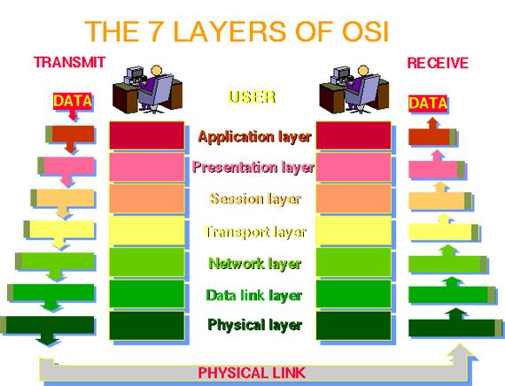
OSI 7 Layer Model

Slide 5
Simplified Network Model
Process
Process
Interface Protocols
Transport
Transport
Peer-to-peer
Protocols
Network
Network
Data Link
Data Link

Slide 6
Addresses at Layers
Physical Layer: no address necessary
Data Link Layer - address must be able to select any host on the network.
Network Layer - address must be able to provide information to enable routing.
Transport Layer - address must identify the destination process.

Slide 7
Type of Inter-Networks
Computer networks may be classified according to the network topology upon which the network is based
  Bus network, Star network, Ring network, Star-bus network, Tree or Hierarchical topology network…
Each topology has advantages and disadvantages
  A ring topology
    makes it easy for computers to coordinate access and to detect whether the network is operating correctly
    However, an entire ring network is disabled if one of the cables is cut
  A star topology
    helps protect the network from damage to a single cable because each cable connects only one machine
  A bus topology
    requires fewer wires than a star,
    but has the same disadvantage as a ring
    A network is disabled if someone accidentally cuts the main cable

Slide 8
Hardware vs. Software
Repeaters are typically hardware devices.
Bridges can be implemented in hardware or software.
Routers & Gateways are typically implemented in software so that they can be extended to handle new protocols.
Many workstations can operate as routers or gateways.

Slide 9
Connection-Oriented vs. Connectionless Service
Connectionless (datagram)
  Connectionless services involve sending of independent messages.
Connection-oriented (virtual circuit)
  A connection-oriented service includes the establishment of a logical connection between 2 processes.
    establish logical connection
    transfer data
    terminate connection.

Slide 10

Advantages of Connection-Oriented
Most applications requires sequential packet delivery - the network should handle the complexity.
Faster Routers. Once a connection is established each router can reference the connection via a small number.
It is better to provide uniform service to a few than to degrade while handling everyone.
Life is easier for the Transport Layer
  possible to calculate round-trip delay
  possible to maximize packet size (it never needs to change).

Slide 11
Advantages of Connectionless
Host software is much simpler at the network layer.
Many applications do not require sequential delivery of packets (example: packet voice).
It is better to provide degraded service to everyone than to limit network access.

Slide 12
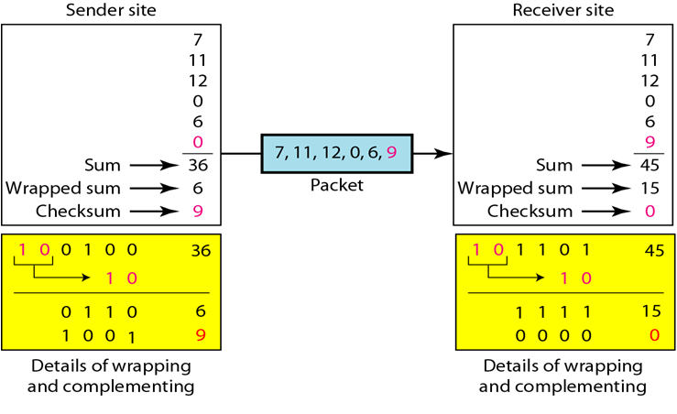
Error Control
Example of Checksums (4 bits)

Slide 13
Network Byte Order
Different computer architectures use different byte ordering to represent multibyte values.
Conversion of application-level data is left up to the presentation layer.
How do lower level layers communicate if they all represent values differently ? (data length fields in headers)
  Networks generally use big-endian order, and thus it is called network order when sending information over a network in a common format.
  The IP design a standard big-endian network byte order for all control data.

Slide 14
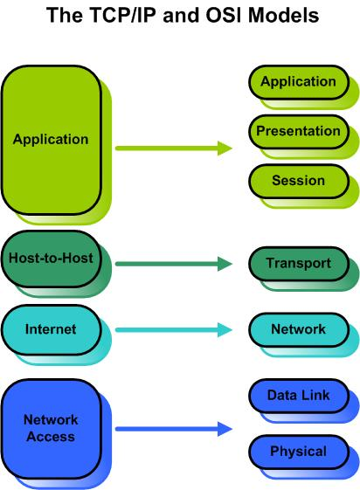
TCP/IP model

Slide 15
Ethernet - A Real Data-Link Layer
Every Ethernet interface has a unique 48 bit address (a.k.a. hardware address).
Example: C0:B3:44:17:21:17
The broadcast address is all 1’s.

Slide 16
IP
IP is the network layer
  packet delivery service (host-to-host).
  translation between different data-link protocols.
IP provides connectionless, unreliable delivery of IP datagrams.
  Connectionless: each datagram is independent of all others.
  Unreliable: there is no guarantee that datagrams are delivered correctly or even delivered at all.
RFC 791: http://www.cis.ohio-state.edu/htbin/rfc/rfc791.html

Slide 17
IPv4 Addresses
IP addresses are logical addresses (not physical)
  32 bits.
Includes a network ID and a host ID.
Every host must have a unique IP address.
IP Addresses are usually shown in dotted decimal notation:
1.2.3.4 00000001 00000010 00000011 00000100

Slide 18
Formats of IP Addresses
Class
A
0
NetID
HostID
B
10
NetID
HostID
C
110
NetID
HostID
D
1110
Multicast ID
E
1111
Experimental ID
8 bits
8 bits
8 bits
8 bits

Slide 19
Special Network Addresses
Addresses beginning with 01111111, or 127 decimal, are reserved for loopback and for internal testing on a local machine.
  You can test this: you should always be able to ping 127.0.0.1, which points to yourself.
There are three IP network addresses reserved for private networks. The addresses are 10.0.0.0/8, 172.16.0.0/12, and 192.168.0.0/16.
  They can be used by anyone setting up internal IP networks, such as a lab or home LAN behind a NAT or proxy server or a router.
  It is always safe to use these because routers on the Internet will never forward packets coming from these addresses.

Slide 20
IP Broadcast and Network Addresses
An IP broadcast addresses has a host ID of all 1s.
  For example, 36.255.255.255 may denote all the hosts on a single hardware network 36.
  The address 255.255.255.255 denotes a broadcast on a local hardware network that must not be forwarded.
An IP address that has a host ID of all 0s is called a network address and refers to an entire network.
  36.0.0.0 means "network number 36" while 36.255.255.255 means "all hosts on network number 36".
IP broadcasting is not necessarily a true broadcast, it relies on the underlying hardware technology.

Slide 21
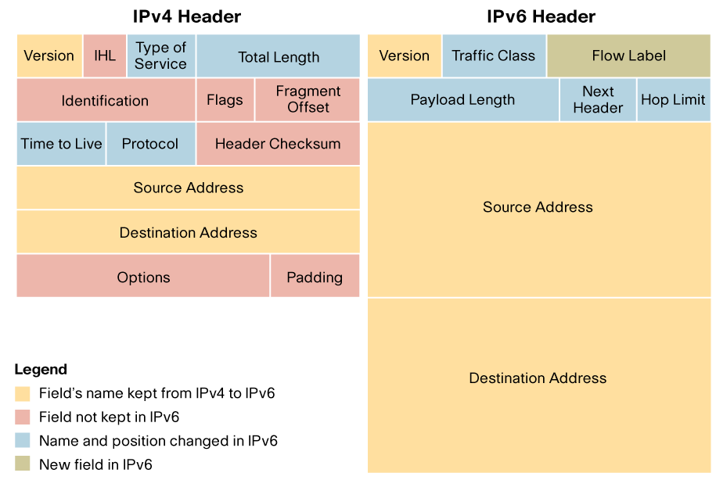
IPv6 Header

Slide 22
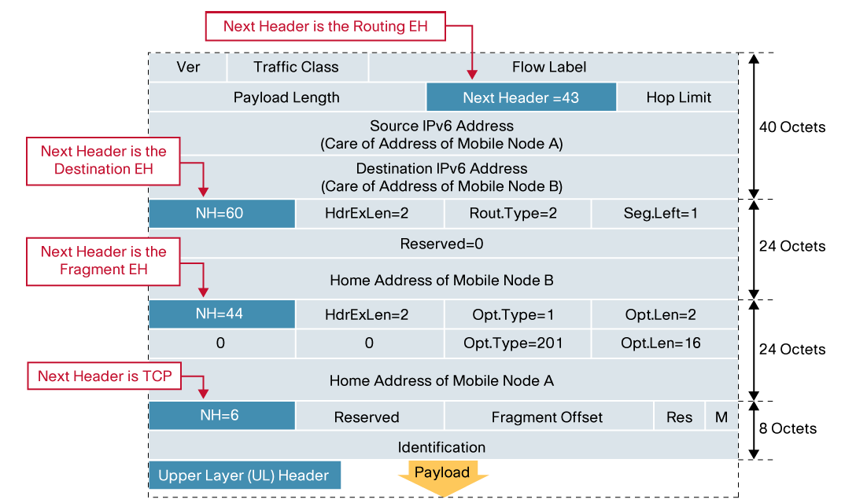
Extension Headers

Slide 23
Mapping IP Addresses to Hardware Addresses
IP Addresses are not recognized by hardware.
If we know the IP address of a host, how do we find out the hardware address ?
The process of finding the hardware address of a host given the IP address is called Address Resolution
The process of finding out the IP address of a host given a hardware address is called Reverse Address Resolution
Reverse address resolution is needed by diskless workstations when booting (which used to be quite common).

Slide 24
ARP/RARP
TCP/IP uses the Address Resolution Protocol (ARP) and the Reverse Address Resolution Protocol (RARP) to initialize the use of Internet addressing on an Ethernet or other network that uses its own media access control (MAC).
The Address Resolution Protocol is used by a sending host when it knows the IP address of the destination but needs the Ethernet (or whatever) address.
ARP is a broadcast protocol - every host on the network receives the request.
Each host checks the request against it’s IP address - the right one responds.
ARP does not need to be done every time an IP datagram is sent - hosts remember the hardware addresses of each other.
Part of the ARP protocol specifies that the receiving host should also remember the IP and hardware addresses of the sending host.

Slide 25
ICMP - Internet Control Message Protocol
ICMP messages generally contain information about routing difficulties with IP datagrams or simple exchanges such as time-stamp or echo transactions.
ICMP is a protocol used for exchanging control messages.
ICMP uses IP to deliver messages.
ICMP messages are usually generated and processed by the IP software, not the user process.
RFC792 http://www.cis.ohio-state.edu/htbin/rfc/rfc792.html
RFC950 http://www.cis.ohio-state.edu/htbin/rfc/rfc950.html

Slide 26
UDP
UDP is a transport protocol
  communication between processes
UDP uses IP to deliver datagrams to the right host.
UDP uses ports to provide communication services to individual processes.
  Each UDP header carries both a source port identifier and destination port identifier, allowing high-level protocols to target specific applications and services among hosts.
RFC768 http://www.cis.ohio-state.edu/htbin/rfc/rfc768.html

Slide 27
TCP
TCP provides a reliable stream delivery and virtual connection service to applications through the use of sequenced acknowledgment with retransmission of packets when necessary.
TCP is an alternative transport layer protocol supported by TCP/IP.
RFC793 http://www.cis.ohio-state.edu/htbin/rfc/rfc793.html
RFC1146 http://www.cis.ohio-state.edu/htbin/rfc/rfc1146.html
RFC1072 http://www.cis.ohio-state.edu/htbin/rfc/rfc1072.html
RFC 1323 http://www.cis.ohio-state.edu/htbin/rfc/rfc1323.html
RFC1693 http://www.cis.ohio-state.edu/htbin/rfc/rfc1693.html

Slide 28
TCP Features
Connection-Oriented
  Connection oriented means that a virtual connection is established before any user data is transferred.
  If the connection cannot be established - the user program is notified.
  If the connection is ever interrupted - the user program(s) is finds out there is a problem.
Reliable
  Reliable means that every transmission of data is acknowledged by the receiver.
  If the sender does not receive acknowledgement within a specified amount of time, the sender retransmits the data.

Slide 29
TCP Features (Conti.)
Data Stream
  Stream means that the connection is treated as a stream of bytes.
  The user application does not need to package data in individual datagrams (as with UDP).
Buffering
  TCP is responsible for buffering data and determining when it is time to send a datagram.
  It is possible for an application to tell TCP to send the data it has buffered without waiting for a buffer to fill up.
Full Duplex
  TCP provides transfer in both directions (over a single virtual connection).
  To the application program these appear as 2 unrelated data streams, although TCP can piggyback control and data communication by providing control information (such as an ACK) along with user data.

Slide 30
TCP vs. UDP
Q: Which protocol is better ?
A: It depends on the application.
TCP provides a connection-oriented, reliable, byte stream service (lots of overhead).
UDP offers minimal datagram delivery service (as little overhead as possible).

Slide 31
Addressing in TCP/IP
Each TCP/IP address includes:
  Internet Address
  Protocol (UDP or TCP)
  Port Number

Slide 32
Creating a Socket
int socket(int family,int type,int proto);
family specifies the protocol family
type specifies the type of service
protocol specifies the specific protocol (usually 0, which means the default).

Slide 33
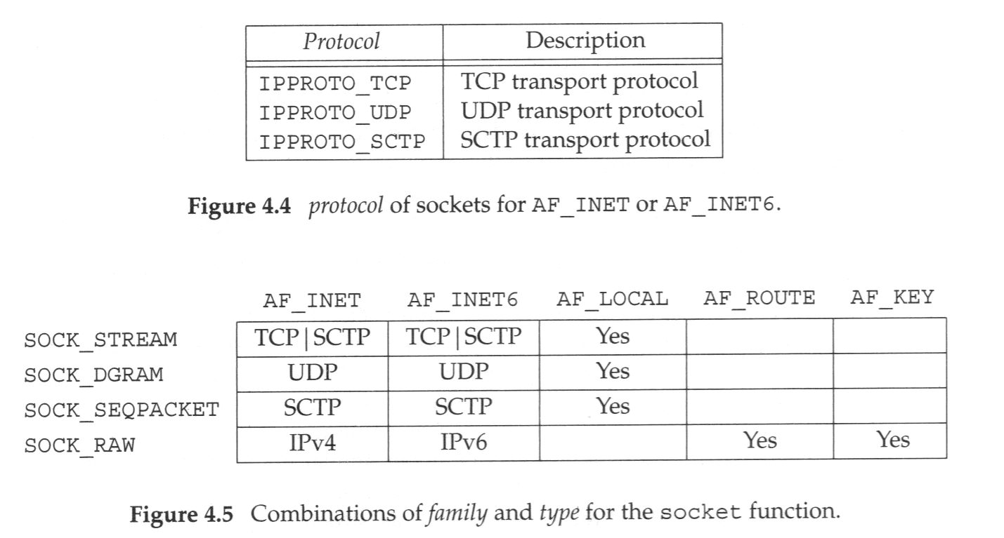
socket()

Slide 34
bind()
calling bind() assigns the address specified by the sockaddr structure to the socket descriptor.
You can give bind()a sockaddr_in structure:
int bind( mysock, (struct sockaddr*) &myaddr, sizeof(myaddr) );

Slide 35
TCP Connection Creation
A client starts by sending a SYN segment with the following information:
  Client’s ISN (generated pseudo-randomly)
  Maximum Receive Window for client.
  Optionally (but usually) MSS (Maximum Segment Size).
  No payload! (Only TCP headers)
When a waiting server sees a new connection request, the server sends back a SYN segment with:
  Server’s ISN (generated pseudo-randomly)
  Ack Number is Client ISN+1
  Maximum Receive Window for server.
  Optionally (but usually) MSS
  No payload! (Only TCP headers)
When the Server’s SYN is received, the client sends back an ACK with:
  Ack Number is Server’s ISN+1

Slide 36
TCP 3-way handshake
Client
Server
SYN
ISN=X
1
SYN
ISN=Y ACK=X+1
time
2
ACK=Y+1
3

Slide 37
TCP Termination
App1
App2
close
FIN
SN=M
1
(active close)
(passive close)
ACK=M+1
2
...
close
FIN
SN=N
3
ACK=N+1
4

Slide 38
TCP Sockets Process Relationship
TCP Server
socket()
bind()
TCP Client
listen()
socket()
accept()
TCP 3-way handshake
block until connection is made
connect()
data
write()
read()
data
read()
write()
notification
close()
read()
close()

Slide 39
listen()
int listen( int sockfd, int backlog);
sockfd is the TCP socket (already bound to an address)
backlog is the number of incoming connections the kernel should be able to keep track of (queue).
listen() returns -1 on error (otherwise 0).

Slide 40
accept()
int accept( int sockfd,
struct sockaddr* cliaddr,
socklen_t *addrlen);
sockfd is the passive mode TCP socket.
cliaddr is a pointer to allocated space.
addrlen is a value-result argument
  must be set to the size of cliaddr
  on return, will be set to be the number of used bytes in cliaddr.

Slide 41
connect()
int connect( int sockfd,
const struct sockaddr *server,
socklen_t addrlen);
sockfd is an already created TCP socket.
server contains the address of the server (IP Address and TCP port number)
connect() returns 0 if OK, -1 on error
return when the connection is established or errors occurs

Slide 42
Value-Result Arguments
A socket address structure is always passed by reference, a point to the structure. The length of the structure is passed as an argument.
Two ways to pass the length:
  From the process to kernel, pass a integer:
    int bind( int sockfd,const struct sockaddr *myaddr, int addrlen);
    int connect( int sockfd,const struct sockaddr *server, socklen_t addrlen);
int
length
Socket address structure
value
Protocol address
kernel

Slide 43
Value-Result Arguments
  From kernel to process, pass a point to an integer. (value-result argument):
    int accept( int sockfd, struct sockaddr* cliaddr, socklen_t *addrlen);
    must be set to the size of cliaddr
    on return, will be set to be the number of used bytes in cliaddr.
int
length
Socket address structure
value
result
Protocol address
kernel

Slide 44
Client Program Example
#include <stdio.h>
#include <sys/types.h>
#include <sys/socket.h>
#include <netinet/in.h>
#include <netdb.h>
void error(char *msg)
{
perror(msg);
exit(0);
}
int main(int argc, char *argv[])
{
int sockfd, portno, n;
struct sockaddr_in serv_addr;
struct hostent *server;
char buffer[256];
if (argc < 3) {
fprintf(stderr,
"usage %s hostname port\n", argv[0]);
exit(0);
}
portno = atoi(argv[2]);
sockfd = socket(AF_INET, SOCK_STREAM, 0);
if (sockfd < 0)
error("ERROR opening socket");
server = gethostbyname(argv[1]);
if (server == NULL) {
fprintf(stderr,"ERROR, no such host\n");
exit(0);
}
bzero((char *) &serv_addr, sizeof(serv_addr));
serv_addr.sin_family = AF_INET;
bcopy((char *)server->h_addr,
(char *)&serv_addr.sin_addr.s_addr,
server->h_length);
serv_addr.sin_port = htons(portno);
if (connect(sockfd,
&serv_addr,sizeof(serv_addr)) < 0)
error("ERROR connecting");
printf("Please enter the message: ");
bzero(buffer,256);
fgets(buffer,255,stdin);
n = write(sockfd,buffer,strlen(buffer));
if (n < 0)
error("ERROR writing to socket");
bzero(buffer,256);
n = read(sockfd,buffer,255);
if (n < 0)
error("ERROR reading from socket");
printf("%s\n",buffer);
return 0;
}

Slide 45
Server Program Example
#include <stdio.h>
#include <sys/types.h>
#include <sys/socket.h>
#include <netinet/in.h>
void error(char *msg)
{
perror(msg);
exit(1);
}
int main(int argc, char *argv[])
{
int sockfd, newsockfd, portno, clilen;
char buffer[256];
struct sockaddr_in serv_addr, cli_addr;
int n;
if (argc < 2) {
fprintf(stderr,
"ERROR, no port provided\n");
exit(1);
}
sockfd = socket(AF_INET,
SOCK_STREAM, 0);
if (sockfd < 0)
error("ERROR opening socket");
bzero((char *) &serv_addr, sizeof(serv_addr));
portno = atoi(argv[1]);
serv_addr.sin_family = AF_INET;
serv_addr.sin_addr.s_addr = INADDR_ANY;
serv_addr.sin_port = htons(portno);
if (bind(sockfd,
(struct sockaddr *) &serv_addr,
sizeof(serv_addr)) < 0)
error("ERROR on binding");
listen(sockfd,5);
clilen = sizeof(cli_addr);
newsockfd = accept(sockfd,
(struct sockaddr *) &cli_addr,
&clilen);
if (newsockfd < 0)
error("ERROR on accept");
bzero(buffer,256);
n = read(newsockfd,buffer,255);
if (n < 0) error("ERROR reading from socket");
printf("Here is the message: %s\n",buffer);
n = write(newsockfd,"I got your message",18);
if (n < 0) error("ERROR writing to socket");
return 0;
}

Slide 46
gethostbyname
struct hostent *gethostbyname( const char *hostname);
struct hostent is defined in netdb.h:
#include <netdb.h>

Slide 47
struct hostent
struct hostent {
char *h_name; /* Official name */
char **h_aliases; /* other names */
int h_addrtype; /* AF_INET or AF_INET6 */
int h_length; /* address length */
char **h_addr_list;
/* array of pointers to addresses */
};

Slide 48
hostent picture
Official Name
h_name
h_aliases
h_addrtype
h_length
h_addr_list
alias 1
alias 2
null
IP address 1
IP address 2
null

Slide 49
Which Address?
On success, gethostbyname returns the address of a hostent that has been created.
  has an array of ptrs to IP addresses
  Usually use the first one:
#define h_addr h_addr_list[0]

Slide 50

gethostbyname() and errors
On error gethostbyname return null.
Gethostbyname sets the global variable h_errno to indicate the exact error:
  HOST_NOT_FOUND
  TRY_AGAIN
  NO_RECOVERY
  NO_DATA
  NO_ADDRESS
All the IP addresses returned via the hostent are in network byte order!
All defined in netdb.h

Slide 51
Don’t try assigning pointer
Getting at the address:
char **h_addr_list;
h = gethostbyname("joe.com");
sockaddr.sin_addr.s_addr =
*(h->h_addr_list[0]);
This won't work!!!!
h_addr_list[0] is a char* !

Slide 52
Using memcpy
You can copy the 4 bytes (IPv4) directly:
h = gethostbyname("joe.com");
memcpy(&sockaddr.sin_addr.s_addr,
h->h_addr_list[0],
sizeof(struct in_addr));

